Slide 1
LinkedIn Network Analysis
Malik Hassan Qayyum

Slide 2
Description
My LinkedIn 1st and mutual connections. Their position title and gender.

Slide 3
Data
Name | Position | First Name | Last Name | Company | Connected On | Gender
1 | Data Analyst | Malik |  | Non Profit |  | M
2 | AI Developer | Syyab | Rahi | Darvis | 1-Nov-17 | F
3 | AI Developer | Shehryar | Ali | Automotive Artificial Intelligence (AAI) GmbH | 1-Nov-17 | M

Slide 4
Data
"Data Analyst"
"AI Developer"
"Analytics Manager"
"BI Developer"
"Data Architect"
"Data Engineer"
"Data Scientist"
"Director of AI & ML"
"Founder and CEO"
"Software Developer"

Slide 5
Type of Graph
Connected
Undirected
Sparse with density 0.13
1 component

Slide 6
Order and Size
36 – vertices
86 - edges

Slide 7
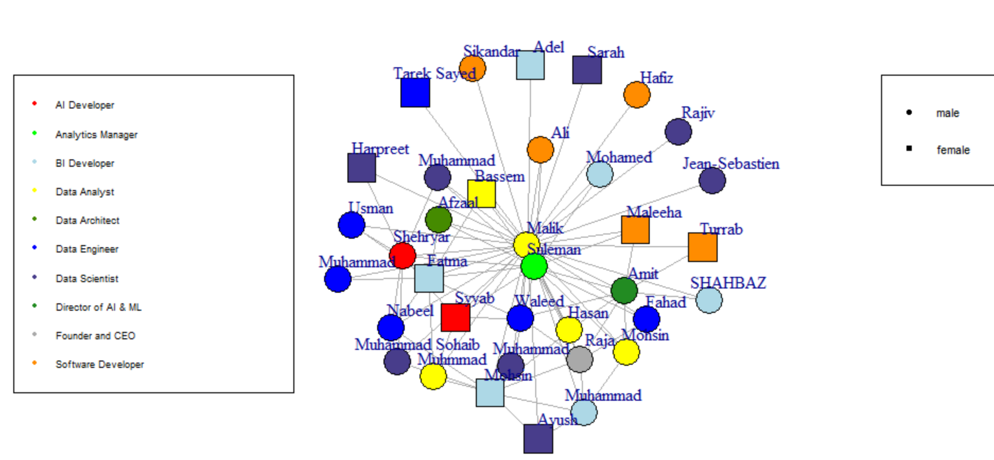
Visualization

Slide 8
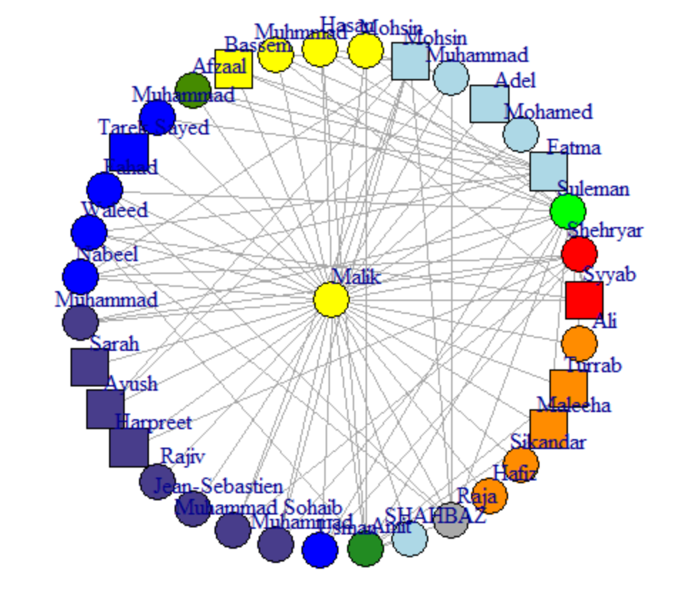
Visualization

Slide 9
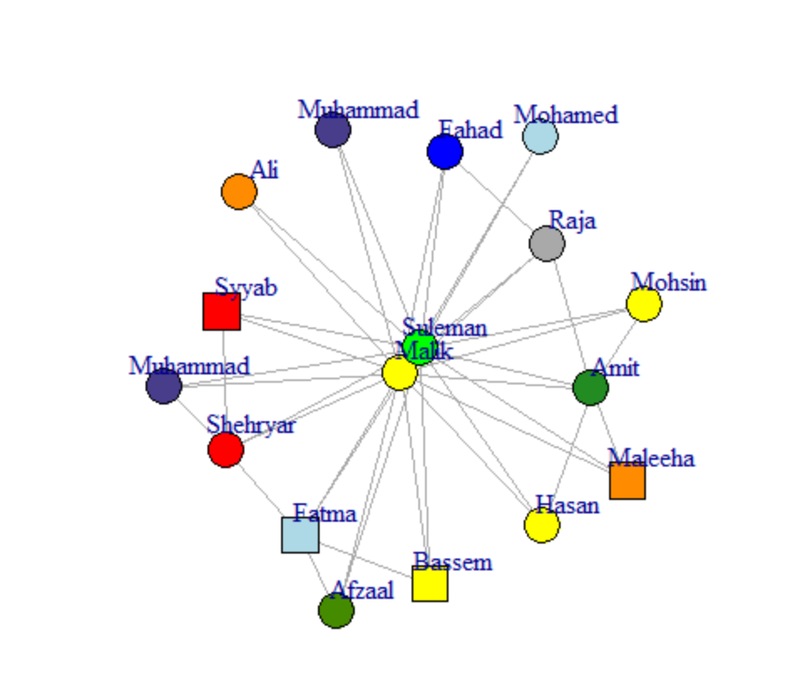
Sulman Analytics Manager

Slide 10
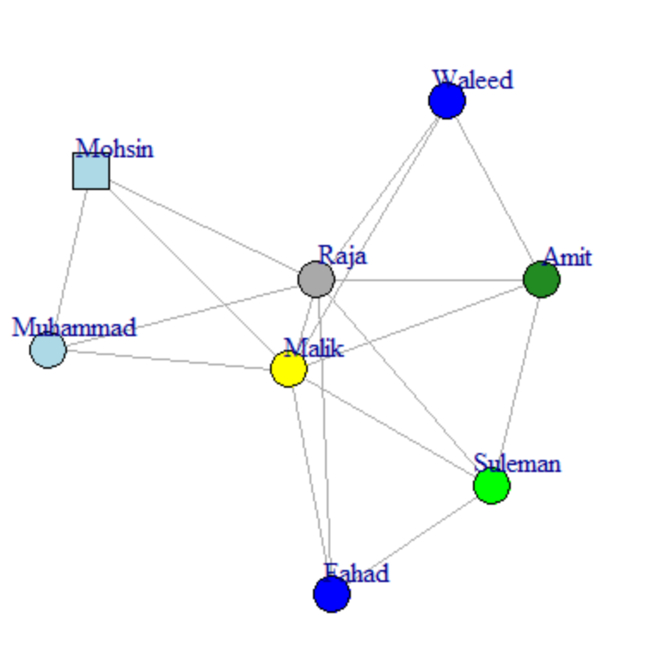
Raja: Founder and CEO

Slide 11
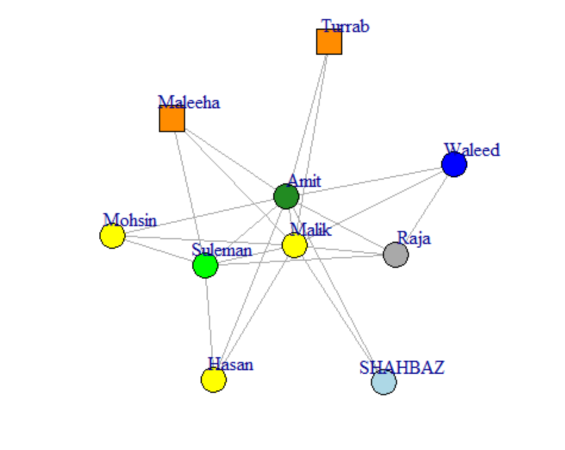
Amit: Director Machine Learning

Slide 12
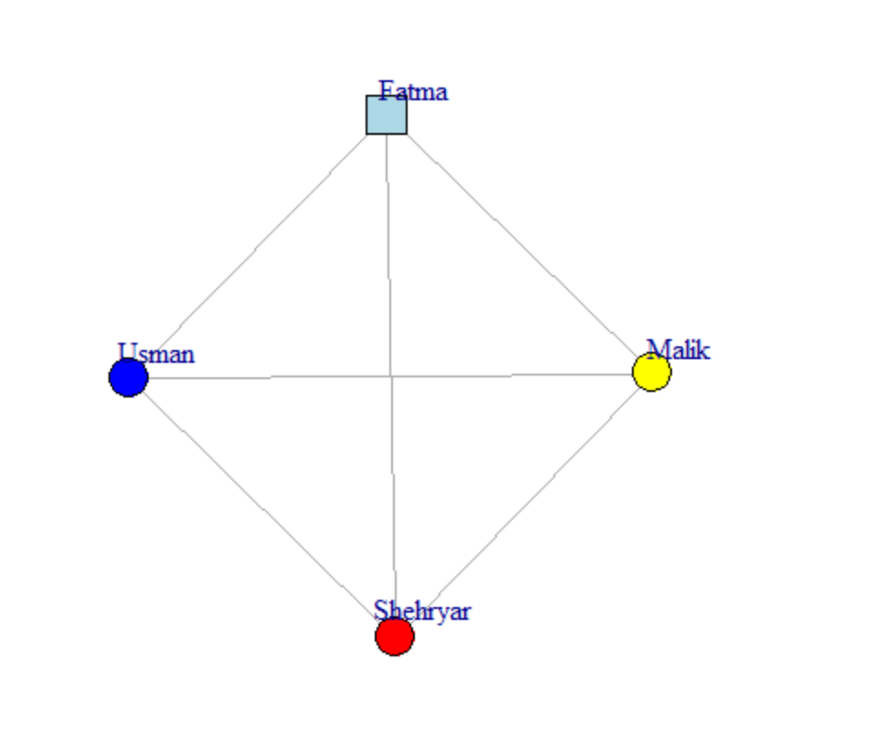
Usman: Data Engineer

Slide 13
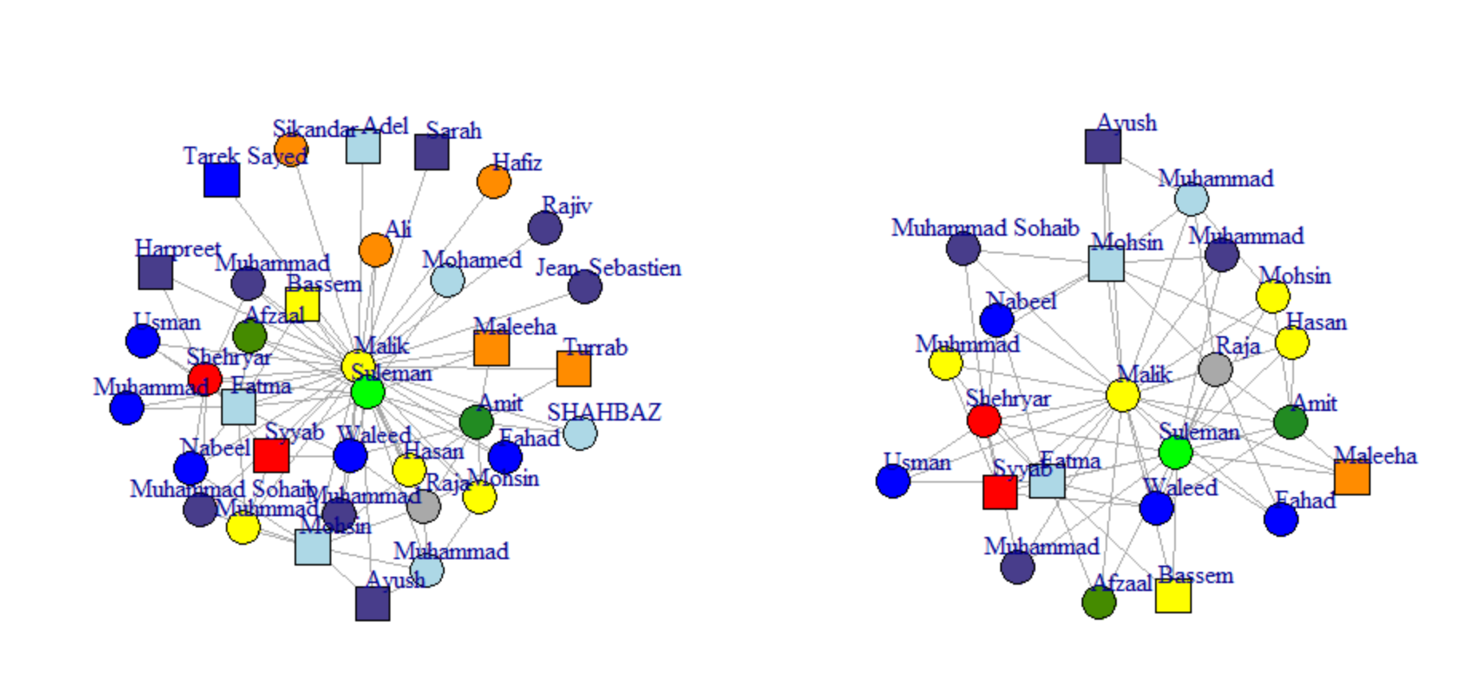
3 core Network

Slide 14
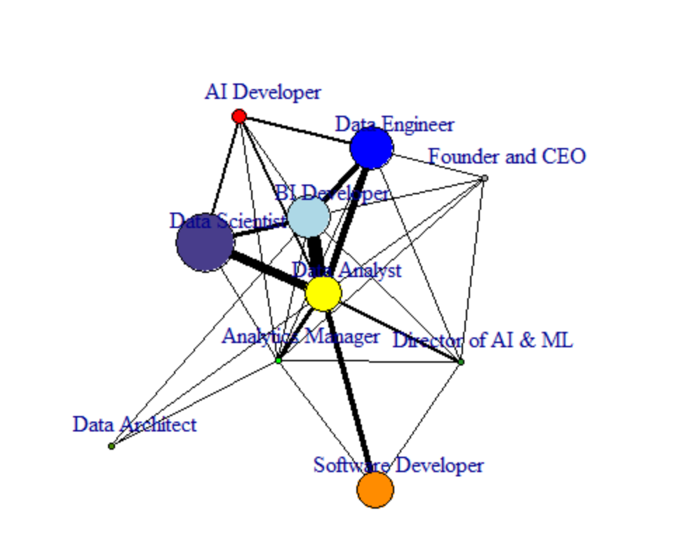
Coarsen

Slide 15
Connectivity
Vertex and Edge Connectivity is 1
Articulation point is Malik

Slide 16
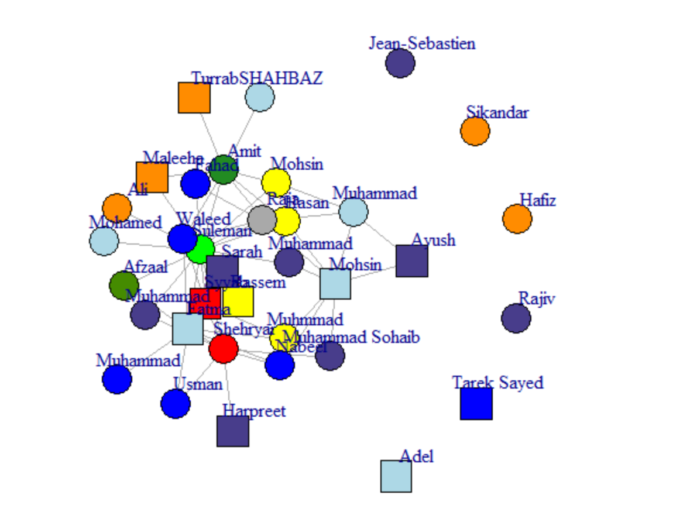
Network without Malik

Slide 17
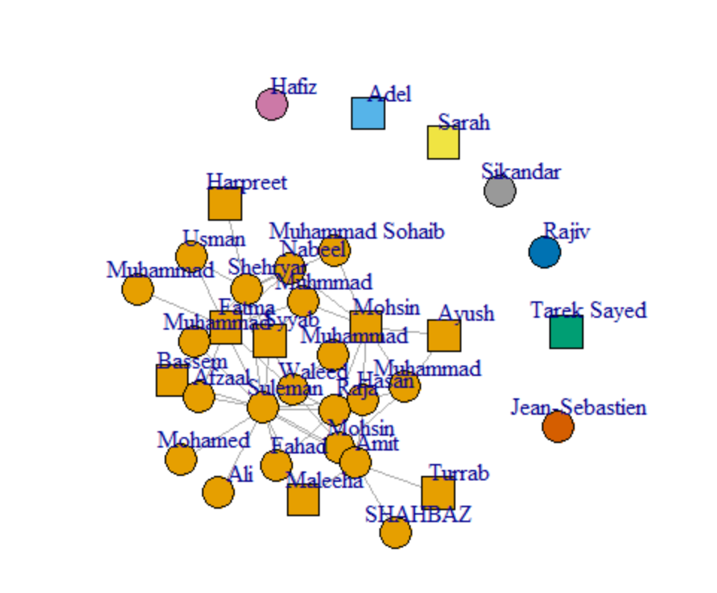
Components
8 components

Slide 18
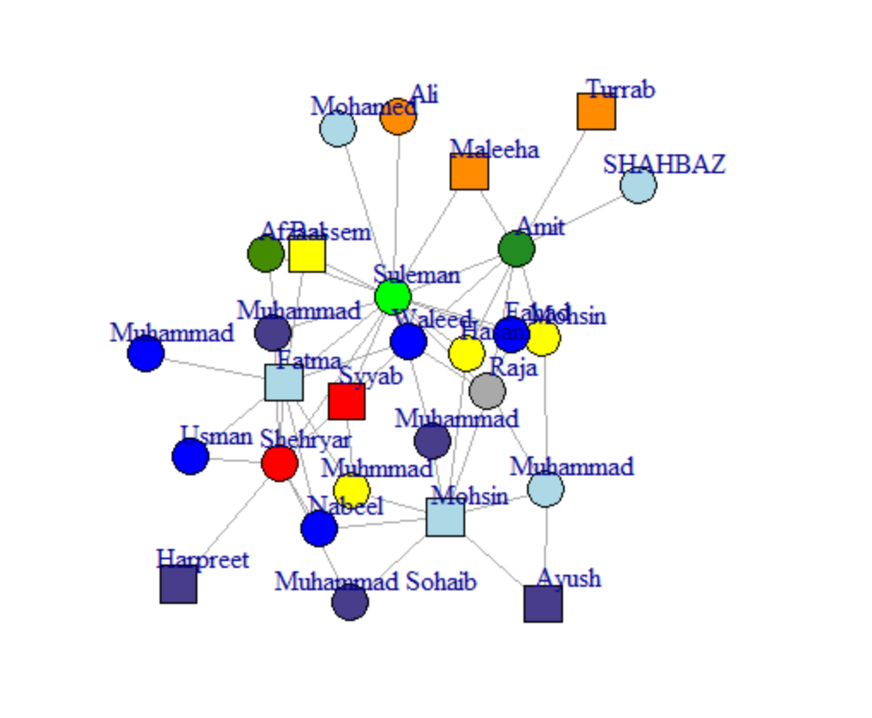
Giant
77% of total network

Slide 19
Cliques
81 Cliques
I.e.
[1] Malik Shehryar Suleman Fatma
[1] Malik Suleman Mohsin Amit

Slide 20
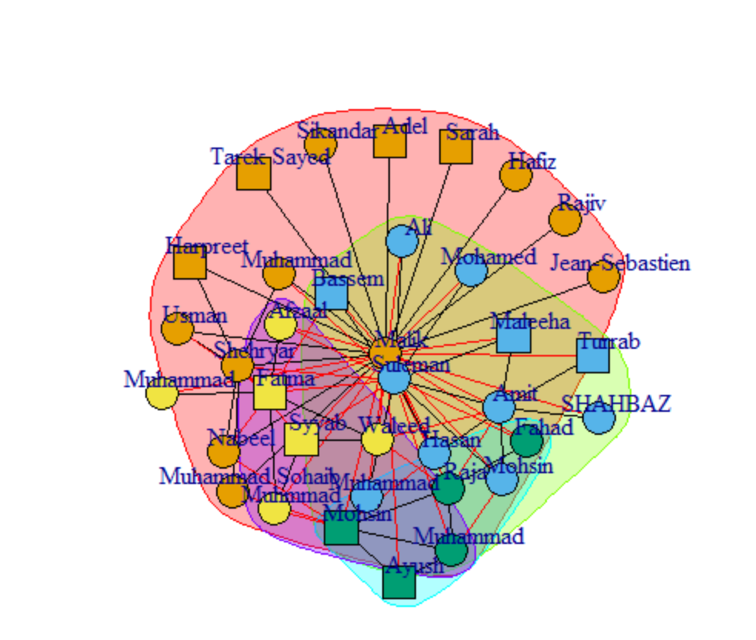
Clustering

Slide 21
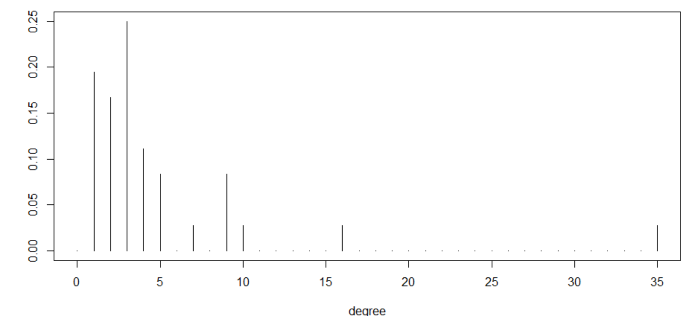
Degree Distribution

Slide 22
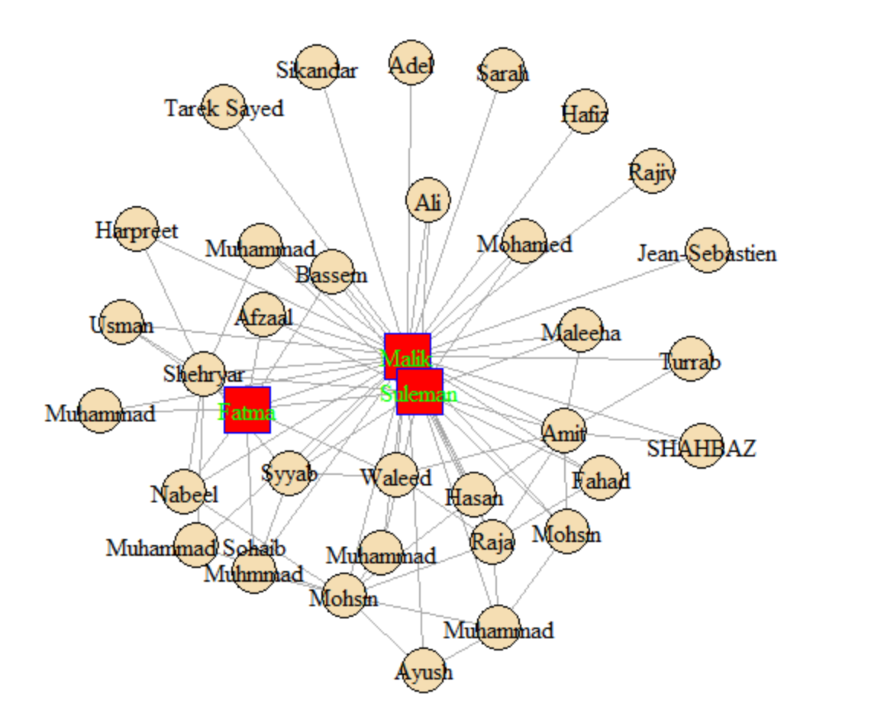
Centrality
Red shape: Degree
Square: Closeness
Blue vertex edges: Betweenness
Light Green label: Eigen Vector

Slide 23
Betweenness: Malik has the highest betweenness centrality; when picking a random two vertices in the network and a shortest path between them, the probability that Malik lies on this shortest path is 0.28%.
Closeness: Malik is be central as it is close to many other vertices

Slide 24
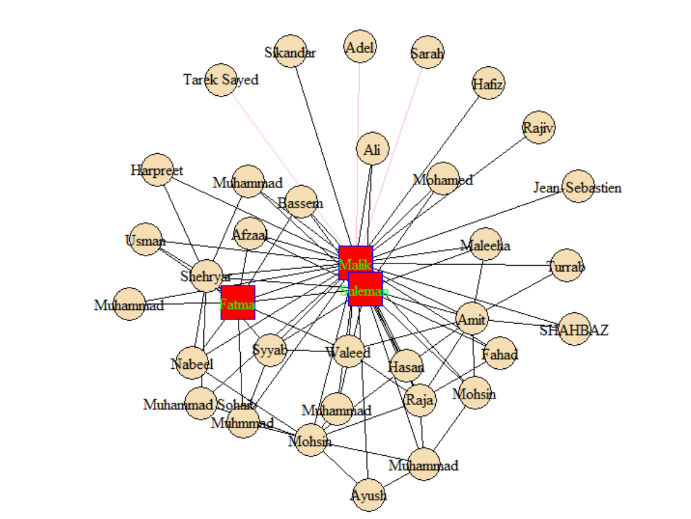
Edge Betweennes
Pink edges*

Slide 25
Assortative Mixing
Transitivity
the probability that a connected triple in a graph is closed: 20%
For both gender and position its negative
Mean Distance
1.863492
Diameter
2

Slide 26
The End

